Slide 1
UG 3 Team 4
Release - 1 Presentation

Slide 2
Problem Statement
Objective: Develop a tool to generate a function-call graph representing inter-language dependencies across the codebase.
Purpose: Enable clear visualization and debugging by tracing function interactions across multiple programming languages.
Benefit: Helps developers quickly locate and understand the flow of logic and cross-language interactions.
Impact: Enhances code maintainability and onboarding by simplifying the understanding of complex, multi-language systems.

Slide 3
Why current solutions fall short?
Limited Scope: Existing tools work well only for single-language (homogeneous) codebases.
Real-World Complexity: Most production systems use multiple languages, making current tools insufficient.
Lack of Cross-Language Insight: Present solutions fail to capture inter-language function calls and dependencies.
Need for Innovation: There's a clear demand for a more robust, language-agnostic tool to handle modern codebases.

Slide 4
Our proposed Solution
Introducing Code Current: A tool designed to resolve cross-language dependency tracking in modern codebases.
Multi-Language Support: Handles interdependencies across Python, Java, C++, and JavaScript seamlessly.
Visual Interface: Includes an intuitive frontend to visualize module and function-level connections across languages.
Insightful Analysis: Offers interactive insights such as code smells, function descriptions, and improvement suggestions.

Slide 5
Technical Implementation
Core Components: Multi-language parsers (C++, Python, Java), unified JSON schema, and interactive D3.js visualizer.
Key Technologies: clang, Python AST, javalang, DeepSeek (for summarization), and D3.js.
Challenges & Solutions: Addressed nested/contextual calls and parsing quirks with custom AST traversal and standardized metadata extraction.
Results: Visualized functional flow across 3 languages; rendered 300+ nodes and 1000+ edges interactively in real-world codebases.

Slide 6
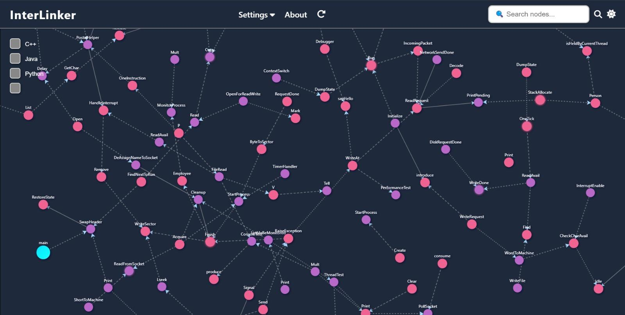

Slide 7
Roadmap – Release 2 Plan
Improve accuracy of function call detection in current languages.
Add inter-language call detection for Python and Java.
Functionality Grouping & Layered Views
Keeping similar color for functions in the same module.
Use identical node shapes for functions written in the same programming language.
Hotspot Analysis
Identify hotspots in the codebase where most function calls are concentrated.
Provide suggestions for optimization or refactoring.
Refactoring Suggestions
Use AI to suggest
Merging similar functions.
Remove unused functions.
Metrics and Reporting
Show metrics like
Number of functions per module.
Number of cross-language calls.
Function call depth.

